Slide 1



Enterprise Legal Intelligence
Contract Risk & Compliance Copilot
AI-powered semantic search, risk detection, and automated redlining.

Slide 2



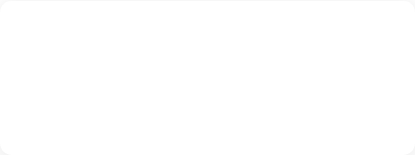
The Problem
Slow & Inefficient
High Costs
Manual contract review processes create massive bottlenecks, taking days to process standard agreements.
Relying solely on expensive outside counsel or senior in-house teams for routine compliance checks drains budgets.
Error-Prone
Lacks Explainability
Human fatigue leads to missed hidden clauses, conflicting obligations, and unmitigated enterprise risk.
Existing 'black box' AI tools fail to provide citations, leaving legal teams unable to verify the source of truth.

Slide 3




The Solution
Intelligent Legal AI Platform
A comprehensive Copilot designed specifically for enterprise legal workflows, merging advanced RAG, Multi-Agent AI, and deterministic rule engines.
Compliance Check
Risk Detection
Contract Analysis
Semantic Search

Slide 4



Objectives & Business Impact
80%
60%
99%
Faster Review
Cost Reduction
Accuracy & Audit
Reduce contract turnaround time from days to minutes with automated first-pass reviews.
Minimize reliance on external counsel for standard compliance and obligation tracking.
Ensure nothing is missed with deterministic entity extraction and full audit traceability.

Slide 5












Technology Stack
Built on a modern, scalable, and secure AI infrastructure designed for enterprise deployment.

Slide 6













System Architecture
PDF/DOCX
PyMuPDF
Vector Store
BAAI/bge

Slide 7





RAG Workflow Architecture
User Query
Retriever
ChromaDB
Prompt Builder
Groq LLM
"What is the liability cap?"
Semantic Search
Fetch Top-K Chunks
Inject Context
Generate Answer

Slide 8


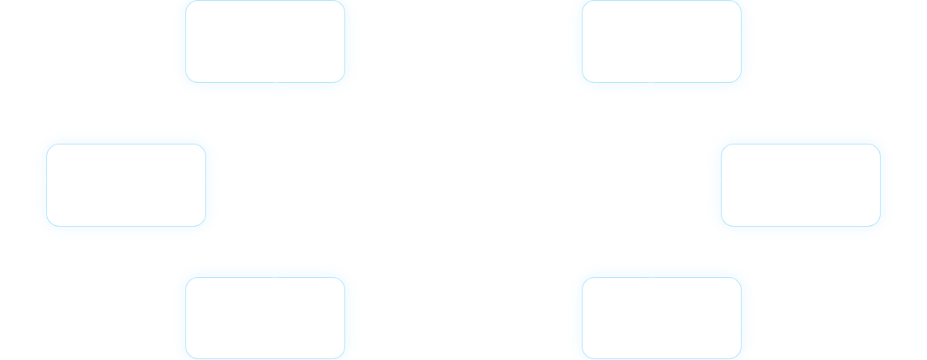








Multi-Agent Architecture
Clause Agent
Entity Agent
Orchestrator
Negotiation Agent
Routes tasks and synthesizes outputs.
Judge Agent
Risk Agent
Compliance Agent

Slide 9


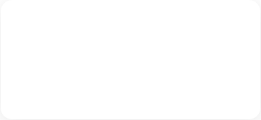
Core AI Engines
Risk Engine
Compliance
Redlining
Identifies unfavorable terms, unlimited liabilities, and non-standard indemnifications.
Validates against internal playbooks, GDPR, HIPAA, and industry-specific regulations.
Automatically suggests inline edits and alternative standard clauses.
Recommendation
Explainability
Summary
Provides negotiation strategies and fallback positions for contentious clauses.
Maps every AI assertion back to the exact source paragraph in the document.
Generates high-level executive briefs highlighting key dates, values, and obligations.

Slide 10




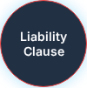

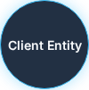
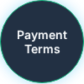
Knowledge Graph Architecture
"Parties"
"Contains"

Slide 11






Contract Comparison (V1 vs V2)
Original Version (V1)
Revised Version (V2)
12.1 Liability.
13.1 Governing Law.
This agreement is governed by the laws of California.
12.1 Liability.
13.1 Governing Law.
This agreement is governed by the laws of California.
Semantic Diff

Slide 12




Citation & Explainability Engine
AI Assessment
Risk Alert: This contract contains a non-standard auto-renewal clause requiring 90 days notice for termination.
Grounded in Source Text
"Term and Termination. This Agreement shall commence on the Effective Date and continue for an initial term of one (1) year. "
MSA_Vendor_final.pdf (Page 4, Section 8.2)

Slide 13



Audit Logging & Traceability
Enterprise compliance requires absolute tracking of AI decisions and user interactions.
[2024-05-20 14:32:01] INFO [System] Document uploaded: NDA_Acme.pdf (User ID: 492)
[2024-05-20 14:32:05] TRACE [Pipeline] Triggered Entity Extraction (spaCy model)
[2024-05-20 14:32:08] TRACE [Pipeline] Document chunked into 45 segments. Embeddings generated.
[2024-05-20 14:32:15] INFO [RiskAgent] Flagged Clause ID: 89a (Unlimited Indemnification). Risk Level: HIGH
[2024-05-20 14:35:22] INFO [API] POST /chat request received. Query: "Summarize liabilities"
[2024-05-20 14:35:23] TRACE [RAG] Retrieved chunks [c12, c18, c41]. Passing to Groq LLM.
[2024-05-20 14:35:25] AUDIT [Security] Response generated and logged to SQLite (Audit ID: 9912)

Slide 14



API Architecture
Built API-first to integrate seamlessly with existing enterprise CLM (Contract Lifecycle Management) tools.
/
System Status & Welcome
/health
Service Health Check (DB, Models)
/upload
Ingest, Parse, Chunk & Embed Document
/chat
RAG Query with Citation Response
/compare
Semantic Diffing of Two Versions

Slide 15


Backend Folder Structure
legal-copilot-backend/
app/
api/ # FastAPI Routers
core/ # Config, Security, DB setup
agents/ # Multi-Agent logic (Risk, Compliance)
services/ # RAG, Extraction, Embeddings
models/ # Pydantic schemas, DB Models
main.py # Application Entrypoint
data/ # ChromaDB & SQLite persistence
tests/ # Pytest suites
Dockerfile
requirements.txt

Slide 16

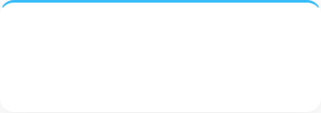
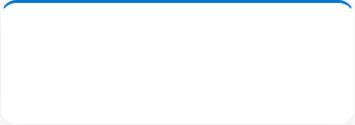


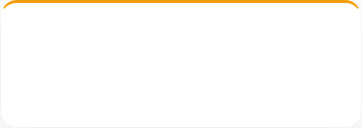

Innovation Highlights
Advanced RAG
Multi-Agent AI
Knowledge Graph
Context-aware chunking preserving legal clause integrity before embedding.
Specialized agents acting as independent reviewers to reduce hallucination.
Mapping entities (Parties, Dates) to obligations for deep relational queries.
Explainable AI
Automated Redlining
Semantic Comparison
Enforced citations linking every output directly to the uploaded source text.
Generates standard playbook-aligned alternative text for risky clauses.
Beyond text diffing—understands if legal meaning changed between versions.

Slide 17

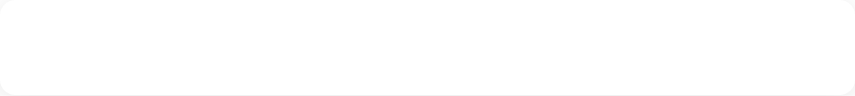




Live Demo Workflow
Document Ingestion
Upload an NDA. System parses PDF, extracts metadata, and generates embeddings instantly.
Risk Dashboard & Summary
View the auto-generated executive summary and the flag on the non-standard venue clause.
Conversational Q&A
Ask: "Are there any mutual indemnifications?" See the AI respond with highlighted source citations.
Compare Tool
Upload a revised V2 of the NDA to demonstrate semantic redlining and diffing.

Slide 18








Future Scope & Roadmap
Enterprise Integrations
Multi-lingual Support
Generative Drafting
Native plugins for Salesforce, Microsoft Word (Add-in), and DocuSign for seamless workflow integration.
Cross-border contract analysis utilizing Llama 3's advanced multi-lingual capabilities for global compliance.
Transition from review-only to full zero-draft creation based on natural language prompts and historical data.

Slide 19


Key Advantages (Why We Win)
Built for Legal Rigor
Verifiable Output
Not a generic wrapper. Tuned specifically for legal ontology, reducing false positives.
Zero hallucination tolerance due to strict RAG citation mapping and source grounding.
Data Privacy by Design
Speed to Value
Architecture supports local LLM deployment and on-premise vector databases.
API-first design allows deployment into existing business processes in days, not months.

Slide 20


Thank You!
Ready to transform legal operations?
https://github.com/harsadhperumal-23/neurobots
harsadhperumal23@gmail.com

